Slide 1
MODULE 3
OSCILLATORS AND REGULATED POWER SUPPLY

Slide 2
OSCILLATORS
Any circuit which is used to generate AC voltage without AC input signal.
To generate AC voltage the circuit is supplied energy from a DC source.
It uses positive feedback
Classification of oscillators
Sinusoidal or Harmonic Oscillators
Non sinusoidal or Relaxation Oscillatotrs

Slide 3
Sinusoidal Oscilaltors
It provides an output having a sine waveform. It can provide frequency ranging from 20 Hz to 1 GHz.
Nonsinusoidal or Relaxation Oscillator
It provide an o/p having square, rectangular or sawtooth waveform.
Classification of sinusoidal oscilaltors
RC oscillators-These oscillators use resistors and capacitors and are used to generate low or audio frquency signals
Eg- RC phase shift Oscillator, Wein bridge Oscillator

Slide 4
2. Tuned circuit oscillators-These oscillators use a tuned circuit consisting of inductors and capacitors and are used to generate the high or radio frequency signals.
Eg-Hartley oscillator, Colpitts oscillator
3.Crystal OScillators- These oscillators use quartz crystal are used to generate highly stabilized signals with frequency upto 10 MHz.

Slide 5
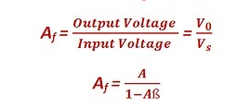
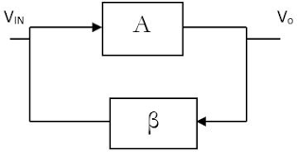
CONDITION FOR OSCILLATIONS
Conditions which are required to be satisfied to operate the circuit as an oscillator are called as “Barkhausen criterion” for sustained oscillations.
The Barkhausen criteria should be satisfied by an amplifier with positive feedback to ensure the sustained oscillations.
For an oscillation circuit, there is no input signal “Vs”, hence the feedback signal Vf itself should be sufficient to maintain the oscillations.
The Barkhausen criterion states that:
• The loop gain is equal to unity in absolute magnitude, that is, | A β| = 1 and
• The phase shift around the loop is zero or an integer multiple of 2π:
The product A β is called as the “loop gain”.

Slide 6
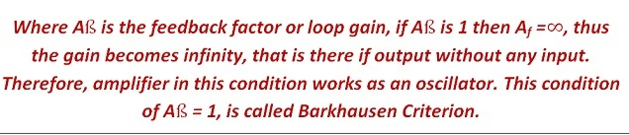
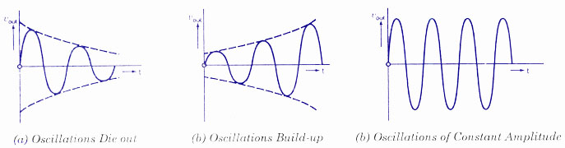

Slide 7
When we turn on the power, the only signals in the system are the noise voltages generated by the resistors.
Every resistor contain some free electrons. These free electrons move randomly in different directions and generate a noise voltage across the resistor.
These noise voltages are amplified and appear at the output terminal. The amplified noises which contain all frequencies, drives the resonant feedback circuit.
Thus initially the loop gain A β is > 1. The oscillations build up.
Once a suitable level is reached, the gain of the amplifier decreases, then the value of loop gain decreases to unity. So the constant level oscillations are maintained.

Slide 8
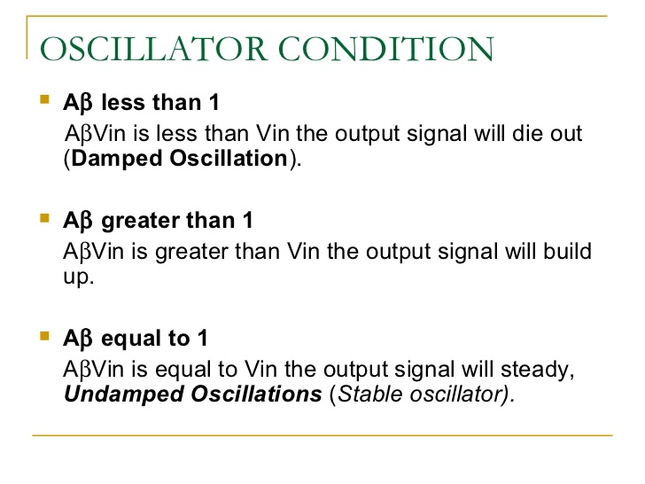

Slide 9
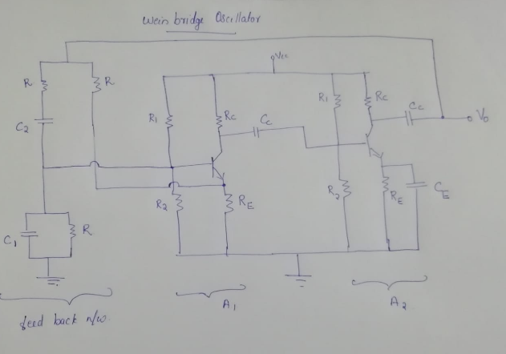
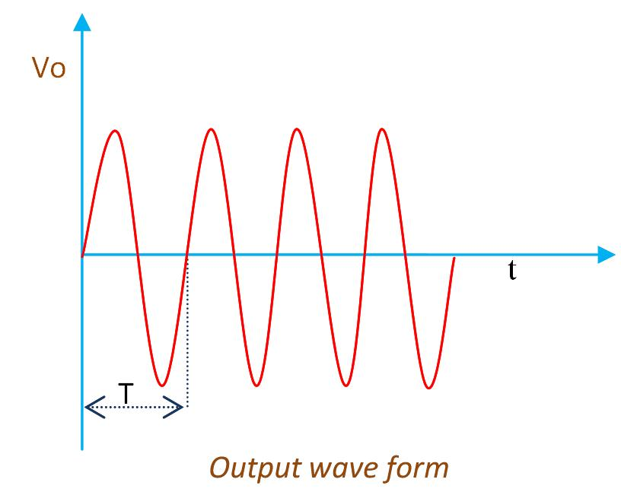
Weinbridge Oscillators
Wein bridge section
Amplifier session

Slide 10
What is an Wien Bridge Oscillator?
The Wien bridge oscillator is an electronic oscillator and produces the sine waves. It is a two stage RC circuit amplifier circuit and it has high quality of resonant frequency, low distortion, and also in the tuning. Due to the advantages like good frequency stability, very low distortion and ease of tuning, a Wien bridge oscillator becomes the most popular audio frequency range signal generator circuit. This type of oscillator uses RC feedback network so it can also be considered as RC oscillator.

Slide 11
The Wien bridge oscillator consists of a 2-stage RC coupled amplifier and a feedback network. The two stage RC coupled amplifier provides a phase shiftnof 360⁰ or 0⁰.
So there is no need to introduce any phase shift by the feedback network.
Voltage across the parallel combination of RC is fed to input of first stage

Slide 12
The feedback bridge consists of RC series elements, RC parallel elements, R3 and R4 resistances. The input to the bridge circuit is applied from the collector of transistor T2 through a coupling capacitor.
When the DC source is applied to the circuit, a noise signal is at the base of the transistor T1 is generated due to the movement of charge carriers through transistor and other circuit components. This voltage is amplified with gain A and produce output voltage 180 degrees out of phase with input voltage.

Slide 13

This output voltage is applied as input to second transistor at base terminal of T2. This voltage is multiplied with gain of the T2.
The amplified output of the transistor T2 is 180 degrees out of phase with the output of the T1. This output is feedback to the transistor T1 through the coupling capacitor C.
A balanced bridge is used as the feedback network.
For a particular frequency the bridge become balanced and for that frequency the phase shift is zero.
Thus in a bridge circuit output will be in phase with input only when bridge is balanced and frequency of oscillation is given by
Under the condition that R₁=R₂=R and C₁=C₂=C, the frequency of oscillation is given by: β = 1/3

Slide 14
ADVANTAGES
It provides low distortion o/p signal over a wide range of audio frequency.
The frequency of oscillation can be easily varied by varying R and C values
The overall gain is high because of 2 amplifier sections
DISADVANTAGES
HArdware requirement is more.
Maximum frequency o/p is limited because of amplifier and phase shift characteristics of amplifier.

Slide 15
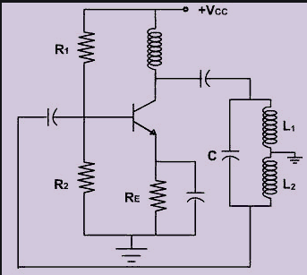
HARTLEY OSCILLATOR

Slide 16
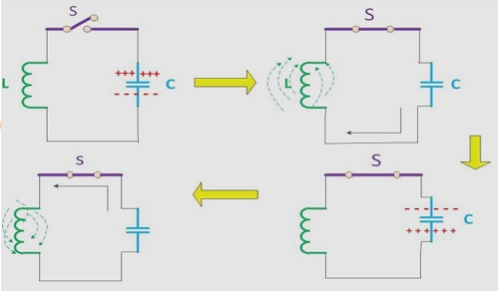
Oscillatory Circuit
The circuit of the oscillator is termed as the tank circuit. It consists of the capacitor and an inductor. The capacitor is already charged and connected to an inductor with the switch between them. When the switch is open, nothing will happen.

Slide 17
When the switch is closed the charge stored by the capacitor will start discharging, and the electrons will start flowing in the circuit. the direction of flow of current in the circuit will be opposite to the direction of flow of electrons.
When the current flows in the circuit, the current will pass from inductor due to which magnetic field is generated. The magnetic field is generated because the current flowing in the circuit will create the flux which in result create the magnetic field.
Due to the magnetic fields around inductor, the energy is stored in the inductor in the form of magnetic field. When the capacitor is fully discharged the current flowing in the circuit will begin to cease. Now the magnetic field which has been created around the inductor will generate emf.

Slide 18
This process of charging and discharging of the capacitor and inductor will continue forever unless the process is terminated externally. In this way, the capacitor will charge at a time, and then inductor will charge at another point of time. Therefore, oscillations will generate continuously.

Slide 19
HArtley oscillators cocsists of 2 inductors L1 and L2 and a capacitor C which acts as feedback network. The o/p of the amplifier is applied across inductor L1 and the voltage across inductor L2 forms the feedback voltage for sustained oscillations.
The coil L1 is inductively coupled to coil L2 and they are wound on the same core.consider the fact that there exists mutual inductance between the coils L1 and L2 their net effective inductive is given by
Leq = L1+L2+2M
The collector supply Vcc is applied to the collector through RFC(RAdio Frequency Choke) which permits easy flow of dc.

Slide 20

The transistor offers 180⁰ phase shift and the remaining phase shift is provided by the tank circuit.
When Vcc is applied C charges and discharges through L1 and L2 and setup oscillations. These oscillations are feedback to the base of the transistor through inductor L2 which appears in the amplified form of the collector circuit.
The tank circuit is getting continuous energy from the amplifier to make up for the losses. Thus sustained oscillations are obtained.
L= L1 +L2 +2M

Slide 21
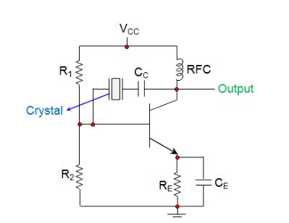
CRYSTAL OSCILLATORS

Slide 22
In crystal oscillators, the usual electrical resonant circuit is replaced by a mechanically vibrating crystal.
The crystal (usually quartz) has a high degree of stability , therefore the crystal oscillators are used whenever great stability is needed.
Quartz crystal exhibit piezoelectric effect. ie. When a mechanical pressure is applied across the faces of the crystal, a voltage proportional to the applied mechanical pressure appears across the crystal . Conversely an alternating voltage applied to a crystal causes it to vibrate at its natural frequency

Slide 23
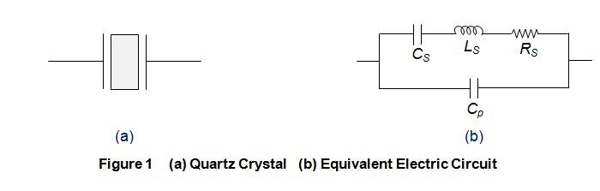

In crystal oscillators, the crystal is suitably cut and mounted between two metallic plates as shown by Figure 1a whose electrical equivalent is shown by Figure 1b.
Due to the presence of C_{p}, the crystal will resonate at two different frequencies viz.,
Series Resonant Frequency, f_{s} which occurs when the series capacitance C_{S} resonates with the series inductance L_{S}. At this stage, the crystal impedance will be the least and hence the amount of feedback will be the largest. Mathematical expression for the same is given as

Slide 24

Parallel Resonant frequency, f_{p} which is exhibited when the reactance of the L_{S}C_{S} leg equals the reactance of the parallel capacitor C_{p} i.e. L_{S} and C_{S} resonate with C_{p}. At this instant, the crystal impedance will be the highest and thus the feedback will be the least. Mathematically it can be given as

Slide 25
Crystal oscillators can be designed by connecting the crystal into the circuit such that it offers low impedance when operated in series-resonant mode
The resistors R₁ and R₂ form the voltage divider network while the emitter resistor R_{E} stabilizes the circuit. Further, C_{E} acts as an AC bypass capacitor while the coupling capacitor C_{C} is used to block DC signal propagation between the collector and the base terminals.

Slide 26
The resulting circuit frequency of oscillations is set by the series resonant frequency of the crystal.
The circuit frequency stability is set by the crystal frequency stability, which is good.

